Slide 1
Modernisation of Rail Route 2, Podgorica – Albanian Border: Feasibility Study and ESIA
WB20-MNE-TRA-02
Kickoff Meeting
19th May, 2020
Podgorica

Slide 2
PROJECT DATA
Beneficiary Ministry of Transport and Maritime Affairs (MoTMA)
Railway Infrastructure of Montenegro (ŽICG)
Lender/ Lead IFI Kreditanstalt für Wiederaufbau (KfW)
Client European Commission, DG NEAR, represented by EIB
WBIF Grant Code WB20-MNE-TRA-02
Resources €1,300k – 27 Experts – 1,710 Expert-days
Start Date 19 May 2020
Duration 15 months

Slide 3
STAKEHOLDERS
Ministry of Transport and Maritime Affairs (MoTMA)
Railway Infrastructure of Montenegro (ŽICG)
KfW as Lead IFI
EIB as IPF9 Contracting Authority (CA) and Client
European Commission, EU Delegation in Montenegro
Ministry of Finance - National IPA Coordinator (NIPAC)
Montenegrin Environmental Protection Agency (EPA)
Railway operation and maintenance companies
City and District authorities

Slide 4
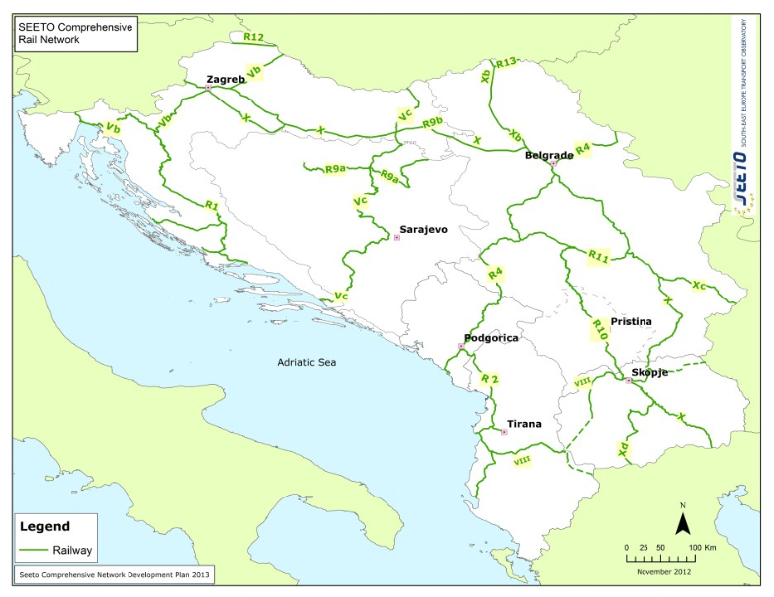
THE PROJECT
Railway line Podgorica – Albanian border (approx. 25 km):
is part of:
the indicative extension of the TEN-T Core Corridor
SEETO Route 2 Comprehensive Network [Podgorica (MNE) – Vlore (ALB)]
does not meet the minimum standards with respect to the TEN-T network regarding:
Speed
Electrification
Length of loops
Signalling

Slide 5
THE PROJECT’S BACKGROUND
New Transport Development Strategy for the period 2019-2035 has been adopted from the Government of Montenegro: the modernization of the Podgorica – Albania border railway line is one of the main priorities
Tuzi station was declared a border station between Montenegro and Albania (June 2017)
Albanian railways are also developing their infrastructure in accordance with international standards

Slide 6
PROJECT’S OBJECTIVES
Develop a Feasibility study for the modernisation of the Rail Route 2, including:
a traffic study,
options analysis,
the conceptual design,
a cost-benefit analysis and
A full environmental and social impact assessment
Overall objective:
making the railway a reliable and competitive mode of transport
increase freight traffic
serve passenger traffic and
establish efficient cross border cooperation

Slide 7
PROJECT PHASES
Inception Phase
Implementation Phase
Feasibility Study & ESIA
Traffic Study
Conceptual Design of preferred development scenario
Financial and Economic Analysis with CBA of the preferred development scenario
Environmental and Social Impact Assessment
Closing Phase
Finalization of Reports
Final Study Workshops
Mobilisation
Inception Report preparation
Development Scenario Analysis and selection of the preferred scenario
Preliminary Environmental and Social Management Plan preparation
Environmental and Social constraints assessment
Traffic Forecasts and Assignments
Identification and analysis of development scenario

Slide 8
DESCRIPTION OF THE CONSULTANCY SERVICES
Inception Period
Mobilization and internal Kick-Off Meeting
Project Kick-Off Meeting
Identification and approval of additional NKEs
Collection and Review of previous studies, reports, records and other documents
Thorough assessment of the existing situation
Preparation of the Inception Report:
The Inception Report is meant to illustrate the activities of this period and give a preview of the proposed management and execution of the project. It will include:
A detailed Work Plan of activities
Suggestions that would enhance and improve project’s performance
Inception Meeting

Slide 9
LIST OF DATA TO BE COLLECTED
Drawings – Engineering and technical data
As build drawings for the existing track
Environmental and social data
Planning documentation of Protected Areas / Emerald sites – Spatial Plans, Management Plans (if any)
Documents-Reports
Traffic Data
Information on related costs and revenues
Any relevant historic costs (of designs, surveys etc) related to the proposed project
Forecasted operation and maintenance costs
Train purchase costs (if the purchase of new trains is required to operate the upgraded line)
Tariff policy / unit revenues/ current total revenues (divided in passengers / freight)
Freight traffic data
Passenger traffic data
Train traffic data
Rail accidents
Albanian Demand Model and reports / Status of the Albanian part of the railway line
Description of the existing situation of the rail network in terms of lines, stations, interoperability issues, electrification, ERTMS, level crossings.
Network statement
The most recent railway development strategy
The most recent update of the SPP
Most recent (Municipal) Spatial Plan(s) and associated Strategic Environmental Assessment document(s)
Structure of the rail sector in Montenegro (infrastructure managers, railway operators etc)
Timetables and travel time on the rail network– also border crossing times and/or other bottlenecks
Stations layouts
As build drawings for existing structures e.g. bridges, tunnel
Typical Cross sections

Slide 10
DESCRIPTION OF THE CONSULTANCY SERVICES
Collection and review the existing traffic data / transport model
Supplementary surveys and data collection
Gaps identification
Development of the Transport Demand Model
Traffic Study
Inception
Preparation of a Traffic Surveys Plan to be agreed with the Beneficiary prior to implementation
The activities will be presented in the Traffic Model Report
Notes:
Having collected and reviewed the existing traffic data / transport model

Slide 11
DESCRIPTION OF THE CONSULTANCY SERVICES
Identification of development scenarios
Identification and description of specific development scenarios (rationale)
“business-as-usual” development scenario,
to limited rehabilitation,
to full modernisation.
“Abandoning the section is not an option.”
with and without:
new signalisation
electrification.
For each development scenario:
Traffic forecasts, assignments and impacts
Assessment of the Environmental and Social constraints
Indicative order of capital expenditure, operation and maintenance costs
Preparation of the Alternative Development Scenarios Report (Interim report)

Slide 12
DESCRIPTION OF THE CONSULTANCY SERVICES
Development Scenario Analysis and selection of the preferred scenario
Comparative analysis of the different Development Scenarios based on:
technical parameters
financial-economic parameters
environmental and social parameters
other parameters (such as safety and accessibility)
Proposal/selection of the preferred development scenario
Preparation of the Development Scenario Analysis Report (Interim report)

Slide 13
DESCRIPTION OF THE CONSULTANCY SERVICES
Conceptual Design of preferred development scenario
Input:
Baseline designs and other supporting documents
Integration of environmental, spatial and resettlement aspects
Elaboration of Masterplan for the stations
Assessment of the requirements for rehabilitation of existing railway structures
Preparation of the Conceptual Design along with its cost estimates
Preparation of the Draft Conceptual Design Report (Interim report)

Slide 14
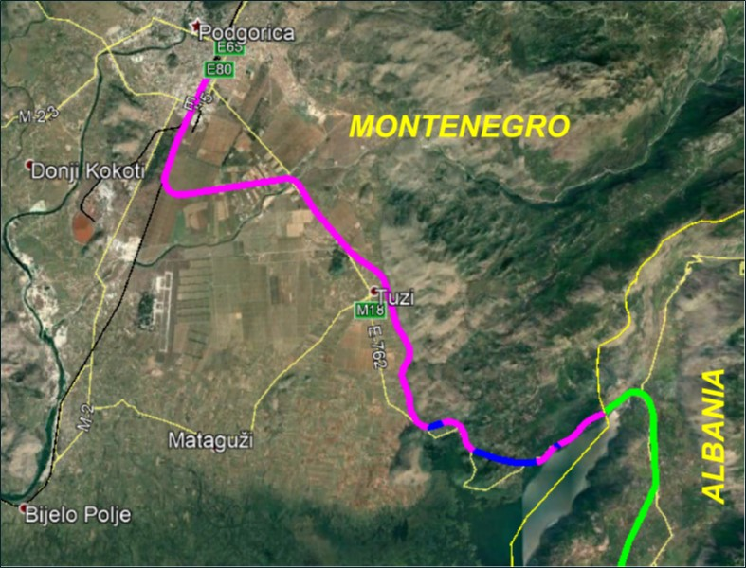
Conceptual Design of preferred development scenario
DESCRIPTION OF THE CONSULTANCY SERVICES
 | General overview of the Line "Podgorica - Tuzi- Border with Albanian"
• | 25 km single track
• | Non electrified line
• | Currently used only for freight trains
• | Design speed 100km/h
 | Due to the poor condition speed 30km/h
 | Main Structures
• | Station Podgorica and Tuzi
• | Passing loop
• | 2 Level crossings
• | 3 Tunnels
• | 5 Bridges
• | 24 Culverts

Slide 15
Conceptual Design of preferred development scenario
DESCRIPTION OF THE CONSULTANCY SERVICES
Activity 2.4 Conceptual design and Costs
Activity 2.3. preferred scenario
Geological Survey
Alignment
Structures
Track
Rehabilitation of existing structures
Road across the railway
New structure (if needed)
Stations
Platforms (TSI req.)
Layout Masterplan
Signalling and Telecommunication
Buildings
Electrification
Assessment
Hydrology
Input, baseline designs and supporting documents

Slide 16
Conceptual Design of preferred development scenario
DESCRIPTION OF THE CONSULTANCY SERVICES
Rolling stock
Structural gauge
Alignment - operation
Stations, open line
Bridges, Tunnel
Electrification
Signalling
Level crossings interlocking
Civil engineering structures
Clearance, Pantograph
RAILWAY INTERFACES

Slide 17
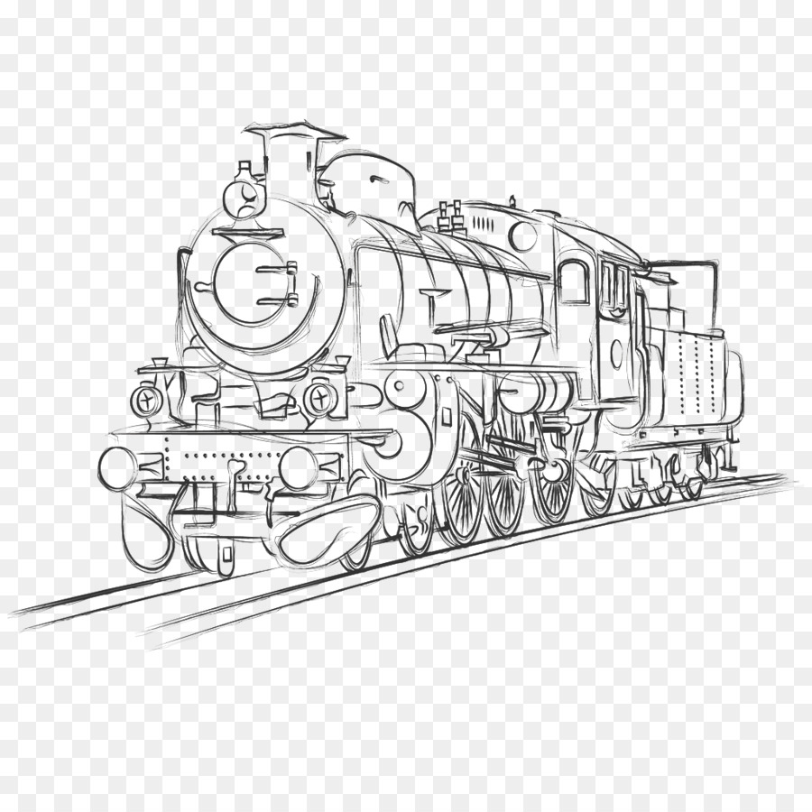
Conceptual Design of preferred development scenario
DESCRIPTION OF THE CONSULTANCY SERVICES
 | Main issues to be considered for the conceptual design
1 | Compliance to the TEN-T Standards
2 | Interoperability standards (wherever possible)
3 | Integrade Environmental aspects
4 | Integrade spatial and resettlements aspects
5 | Provision of the UIC-GB gauge
6 | Electrification with OCL
Preparation of the Draft Conceptual Design Report (Interim report)

Slide 18
DESCRIPTION OF THE CONSULTANCY SERVICES
Financial and Economic Analysis with CBA of the preferred Development Scenario
Input:
Cost estimates derived from the Conceptual Design activity
Traffic assignments
E&S assessment
Financial analysis / Economic analysis
In line with EU CBA guidelines
Preparation of:
the draft financial-economic model and
the financial-economic model guidelines
Preparation of the Draft Feasibility Study Report

Slide 19
DESCRIPTION OF THE CONSULTANCY SERVICES
Environmental and Social Impact Assessment
Review of background information, policy guidelines and relevant legislation
Preparation of the Scoping Report and the detailed ESIA Work Plan
Specific attention will be paid to issues related to:
Physical environment
Biological environment
Social, economic and cultural environment
Preparation of the draft ESIA package including;
Draft Initial SEP, Draft P-ESMP, NTS
Draft ESIA Report
Draft LARPF
Notes:
Stekeholders Engagement Plan, Preliminary E&S Management Plan, Non-Technical Summary
Draft Land Acquisition and Resettlement Policy Framework

Slide 20
DESCRIPTION OF THE CONSULTANCY SERVICES
Project Close-out
Final Study Workshop
Preparation of the Final ESIA Report, including:
Final P-ESMP
Final LARPF
Final SEP
Final NTS
Preparation of the Final Conceptual Design Report
Preparation of the Final Financial Model
Preparation of the Final Feasibility Report
Preparation of the Project Executive Summary

Slide 21
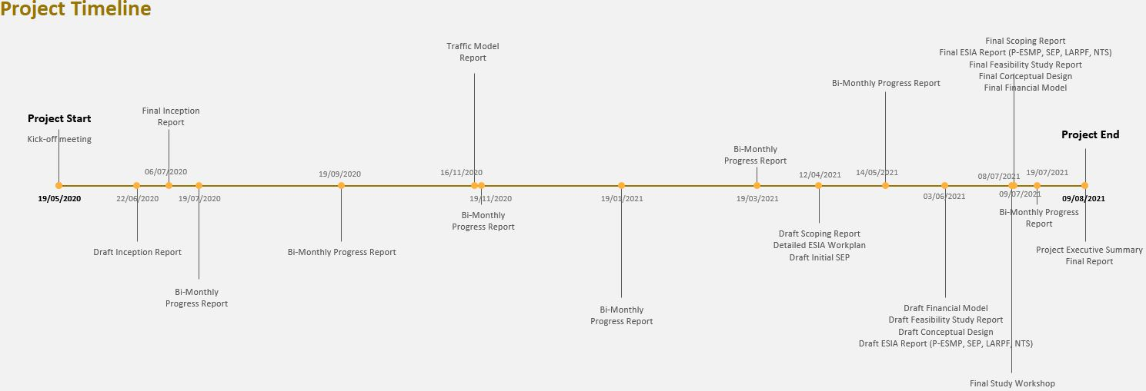
PROJECT TIMELINE
* Interim reports / Technical Notes to be described and proposed in the Inception Report

Slide 22
RISKS
Insufficient cooperation between the parties involved
Early mobilisation
Continuous collaboration
Lack and/or loss and/or decline of political will to promote the Project
Efficient communication with the stakeholders involved
Proper dissemination of the project’s purpose
Lengthy data collection period / Inconsistency of existing data / Lack or inadequacy of data
Early review of data and early identification of missing data/information
Continuous cooperation with MoTMA/ŽICG
References in Montenegrin will be translated
Lack or delay on providing the existing transport model / inadequacy of data regarding the Albanian section
Use of other existing transport models (REBIS, Podgorica bypass, AIC etc.)
Adequate market research and/or traffic demand surveys for the estimation of potential demand from the Albanian side

Slide 23
RISKS
Technical incompatibility of rail infrastructure in Montenegro and Albania
Establishment of proper coordination with the respective stakeholders in Albania
Actions and comments / approvals are not provided in due time
Continuous cooperation with the PIU
Some counterparts’ reluctance to work/communicate in English
Ability of some team members to communicate in Montenegrin
Travel restrictions due to the pandemic banning the international experts from visiting Montenegro or limiting experts’ movements around the country
Strengthening the team with local experts (to liaise with the local authorities and key stakeholders)
Local Railway expert, already approved and mobilized
Additional local experts identified – CVs to be submitted for approval asap
Using technology (Skype, Zoom etc) to perform meetings
Coordinating with client and beneficiary to adjust the workplan (if and where needed)

Slide 24
LANGUAGE - COMMUNICATIONS
All formal communications will be in English.
Communications on technical issues with the local experts can be also made in Montenegrin.
Deliverables will be prepared in English and their final versions will be translated to Montenegrin. All other reports will be prepared in English.
Deliverables will be submitted to the PIU, KfW and EUD. The PIU shall ensure their distribution to other stakeholders.

Slide 25
NEXT STEPS
Identification and approval of NKEs
Establishment of communication links
Collection of all related inputs (studies, regulatory requirements, local rulebooks and guidelines)
Review of previous studies and background information, thorough assessment of the current situation
Definition of the structure for the Feasibility Study and ESIA documentations
Site visit
Development of a detailed work plan (sub-activities, relationships, milestones, deliverables)
Preparation of the Inception Report

